Slide 1

Binary Trees
Data Structures and Problem Solving
COMP232
Dickinson College
Slides created by Professor Grant Braught with substantial additions by Professor Farhan Siddiqui
Minor changes by John MacCormick

Slide 2



1. Introduction
4. Binary Trees
3. Generics and Linear Structures
3. Analysis
2. Recursion and Backtracking

Slide 3
Binary Trees
Tree is a non-linear data structure which organizes data in a hierarchical structure
A binary tree is a tree with:
  Nodes that have 0, 1 or 2 child nodes
  Children are distinguishable: left / right
Some binary trees:
Notes:
One on the right may not look like a binary tree, but technically it is - it is just highly unbalanced.
Draw another on the board where it zig-zags (right child / left child / right child etc…)

Slide 4
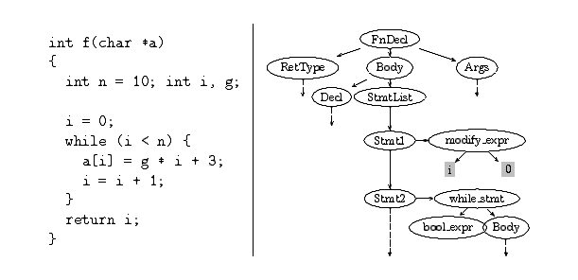
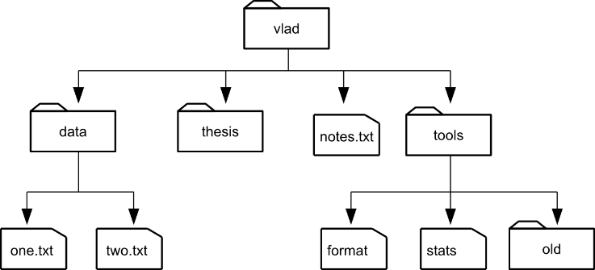
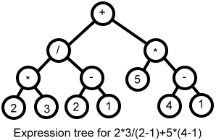
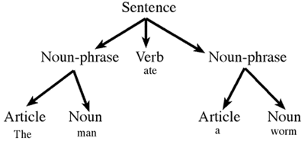
Some Tree Structures

Slide 5
Tree terminology

Slide 6
Tree terminology

Slide 7
Tree terminology

Slide 8
Tree terminology

Slide 9
Tree terminology

Slide 10
Tree terminology

Slide 11
Tree terminology

Slide 12
Tree terminology
Arity/Degree/Order of a tree: Maximum number of children its nodes can have
Nodes of a “k-ary” tree can each have at most k children
(Binary trees have at most 2 children)

Slide 13
Tree terminology

Slide 14
Tree terminology

Slide 15
Tree terminology

Slide 16
Tree terminology

Slide 17
Tree terminology

Slide 18
Recursive View of Binary Trees
Binary trees have a recursive structure.
  For any node in the tree, its left and right children (if any) are the root of a smaller binary tree.
a
b
c
right sub-tree
of a
left sub-tree
of a
g
f
e
d
h
i
j
Notes:
Left sub-tree of b is the tree rooted at g.
Right sub-tree of f is the tree rooted at f.
Left sub-tree of c is the single node tree e.
What this structure means is that if we want to do something to every node in the tree we can do it recursively.
Imagine I have a function X that can be performed on a node in the binary tree.
Then to apply it to the whole tree I can: {Write on board…}
Do X to whole tree:
Do X to the root
Do X to the left sub-tree
Do X to the right sub-tree
When we do X to the left sub-tree it will recursively…
Do X to the root of that sub-tree (e.g. b)
Do X to the left sub-tree of that sub-tree (e.g. tree rooted at g)
Do X to the right sub-tree of that sub-tree (e.g. tree rooted at f)
The other three traversals are based upon this notion.

Slide 19
Binary Tree Traversals
Four ways to traverse a binary tree:
  Level-order traversal
    Breadth-first
    a b c g f e d h i j
  Pre-order traversal
    Depth-first
    Root, left, right
    a b g h i f j c e d
  In-order traversal
    Left, Root, Right
    h g i b j f a e c d
  Post-order traversal
    Left, Right, Root
    h i g j f b e d c a
a
b
c
g
f
e
d
h
i
j

Slide 20
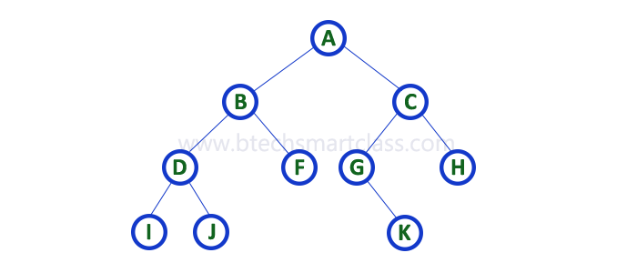
Binary Tree Traversals
Notes:
Level:
Pre:
In:
Post:

Slide 21
Binary Tree ADT
K
V
BinaryTree<K,V> - K = key type, V = value type
size() – total number of nodes
contains(K key) – return true if the tree contains a node with the specified key
V get(K key) – return the value of the node with the specified key (or return null)
set(K key, V value) – set the value of the node with the specified key (or
NoSuchElementException)
add(K key, V value)- add a node with a specified key-value pair to the tree
V remove(K key)- remove a node with the specified key and return its value (or return null)
Visit Pre/In/Post Order(CS232Visitor<K,V> visitor) – visit the nodes in this order and invoke the specified visitor on each node.

Slide 22
Binary Tree ADT
cs232BinaryTree.java (Interface)
cs232Visitor.java (interface)

Slide 23
a
  Post-order traversal
    Left, Right, Root
    h i g j f b e d c a
b
c
g
f
e
d
h
i
j

